Slide 1
A Generalized Assessment Model to Obtain Consistent Management Advice from Diverse Data
Richard D. Methot Jr.
Science Advisor for Stock Assessments
World Conference on Stock Assessment Methods
Boston, MA
July 17, 2013

Slide 2
Stock Assessment Goals
What harvest policy is sustainable and provides balance between preventing overfishing and attaining maximum fishing opportunities?
Does current level of fishing (F) exceed that policy?
Has abundance (B) been so reduced by past fishing as to put the stock and ecosystem at risk?
What future catch would implement the policy?

Slide 3
Assessment Data and Situations
DATA
Catch only
Catch and stock abundance
Catch, abundance and/or composition
Add ecosystem/ climate/ habitat factors
SITUATIONS
Short time series vs. long-term series containing contrast
High F vs. low F
Stable biology vs. environ/eco driven changes in process
Degree of stock fluctuations (M + sigmaR)
Degree of spatial viscosity
Notes:
No sharp lines above, so need models that perform well across a continuum

Slide 4
Assessment Approaches
Catch Only
Time series, no biology
Biomass Dynamics
Simple tuning factor
Time series tuning
STATISTICS: measurement vs. process error
Age and/or Size Structured
Noisy data with gaps
Full catch-at-age
STATISTICS: Penalized pseudo-likelihood, Integration across random effects, Kalman filter
Multi-Species with M and/or technological linkages
Added Features:
Spatial
Multi-species
Covariates
Notes:
You’ll hear more about this later in the conference

Slide 5
Biomass vs. Age Model Dichotomy
Biomass Dynamics
r, K parameters
Age-Structured
Empirical Reconstruction;
Then Spawn-Recruit
F_{msy} gives B_{msy}
near 0.5*K
F_{msy} gives B_{msy} near 0.3*K, or lower.
Use 3-parameter forms that align these approaches;
Don’t ignore effects on SSB when using F_{max} as F_{msy} proxy
Notes:
Acknowledge Mangel, Brodziak, MacCall and others

Slide 6
Desirable Model Characteristics
Measures F, B, and productivity
Estimates reference points and does forecasting
Assimilates diverse types of data
Consistency (no dichotomy as on previous slide)
Statistically rigorous
Biologically realistic
Responsive to time-varying ecosystem/environmental processes
Easy to use; includes A.I. to guide good usage practices
Spatial
Multi-species

Slide 7
How do Data Influence Assessment Results in a Generalized Model – Stock Synthesis?
Consider three data situation
Scalar observation at end of time series
Mean length
Current F
B_{current} / B₀
Time series of relative abundance
Composition data
Perfectly precise ages
Ages with ageing imprecision
Lengths

Slide 8
Example Simulated Population
H=0.7;
σ_{R}=0.4;
M=0.2

Slide 9
Generate and Analyze Simulated Data Using Stock Synthesis
Analyze each data scenario using Stock Synthesis (SS)
Allow estimation of some or all of:
Steepness
Selectivity
M
Recruitment deviations
Growth
Use informative priors in a penalized likelihood framework
Focus on variance of model results
Fishery age, length, and imperfect ages beginning in 1971
Survey of spawning biomass beginning in 1981
Various scalar measures in 2010
Notes:
You will see some more extensive work of this sort later in the session from students at UW

Slide 10
Results with Simple Data
Relative Depletion in 2010
F in 2010
Survey Time Series
Mean Length in 2010
Survey
Notes:
Display 4 model fits +/- one stderr
Steepness estimated and goes to the prior, except for the survey time series because the time series provides info on the rate of decline.
Accurate, but only because I gave it the right values
Not precise

Slide 11
Results with Composition and Survey Data
Imperfect Ages
Lengths (growth known)
Perfect Ages
Lengths (growth estimated)
Notes:
With growth parameters estimated, some of the information in the length comps goes into estimating those parameters,
So the weak prior on steepness is now relatively more informative and the result moves towards the correct result

Slide 12
Age Data and Survey; Est. Selec. Process Error
No Process Error
+9 Parameters for Proc Error
Add M estimation
Ignore all priors

Slide 13
Simulation Summary
Catch time series plus some simple indicator of F is highly informative
Three types of composition data ~ equally informative
Truly random data
Repeated observations of each cohort
Adding process error in estimation did not greatly degrade precision
A generalized model enables blending information from diverse data and making comparisons such as this
Lightly informative priors are important part of approach
Real data must be much worse than random measurement error

Slide 14
Other Simulation Studies
Fidelity of M and h estimation in assessment models (Lee, Piner, Maunder, Methot)
Recruitment lognormal bias adjustment protocol to obtain consistent results in Max Likelihood estimation (Methot and Taylor)
Effect of spatial structure on performance of assessment models (various)
Reports from the UW team to be presented today

Slide 15
Parameter Priors and Linked Assessments
Meta-analysis: Two recent papers by Thorson, Taylor, Stewart and Punt develop a mixed effects model to integrate results across SS applications for several west coast species
Estimate life history ratio: M/K
Estimate coherence in recruitment deviations
Survey Q, F, survey process errors, and other factors are amenable to derivation of informative priors by linking assessments of multiple, co-occurring species

Slide 16
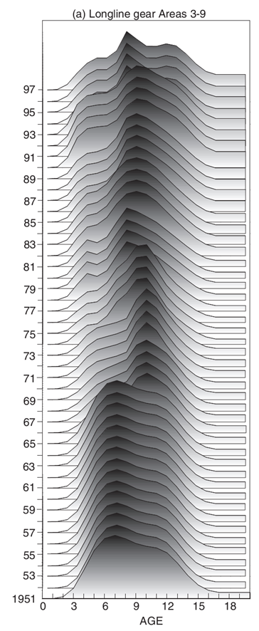
Are We Estimating the Right Factors?
Some Common Practices
Hold M constant, but contemporary M is among the least known factors!
Put parametric, or complex non-parametric (right), statistical constraints on selectivity of fisheries
Use age-specific surveys, so each has fully independent Q
Treat survey Q’s as having only uninformative priors
Estimate population conditioned on above, but many degrees of freedom in the age composition data go into the selectivity estimation

Slide 17
What Could We Do Differently?
Gear experiments, tagging studies and spatial distribution studies to make direct measurement of selectivity, or linkage of Q between ages in survey; include goodness of fit to selectivity data in models
Gear experiments and and spatial distribution studies to put priors on overall survey Q
With information on Q and selectivity; M estimation becomes more feasible

Slide 18
Ecosystem and Assessment Models
CLIMATE
FOOD WEB
M=M1+M2
Z_{t} = M + F_{t}
R_{t} = f(SSB) + e_{t}
OTHER
ASSESSMENT BOX
C_{t} = N_{t} * F_{t}/Z_{t} * (1-exp(-Z_{t}))
N_{t,a} = N_{t-1,a} *exp(-Z_{t})
Notes:
All models are simplifications
Some factors, F_{t}, are inside the system being modeled and we seek to measure this factor
Other factors, e.g. M, are also inside the system. By holding it constant, we simplify the system and allows for estimation of F, conditional on M.
In reality, M is controlled by factors, E, outside of the system.

Slide 19
Three Approaches
Deterministic: Expand system so that M_{t} = f( E_{t}) is now inside the system
Multi-species models take this approach (Curti et al)
Also recruitment driven by environmental time series
Random Effects: Treat M_{t} as a random process and integrate over the range of possible values to obtain an estimate of the average performance of the system, and its variance. The posterior distribution of M is determined by the prior on M and the information in the conventional “inside the system” data. E remains outside the model system.
E as DATA, like a survey of the state variable M.

Slide 20
External Factors as Data Regarding Deviations
Expected value of factor E_{t} is a function of state variable M_{t}. Same logic as expected value of a survey is a function of the state variable Biomass_{t.}
Model includes the logL from deviations (E_{t} - e(E_{t}) ) in the objective function
Example:
Recruitment as a random process with annual values R_{t}
A survey, O_{t}, of young fish is considered a measure, with sampling error, of R_{t ,} so e(O_{t})=f(R_{t})
This survey could have been an annual measure of some environmental factor. From the assessment model’s perspective it is just a datum that is informative about R_{t}
The estimates of the R_{t} will depend upon the conventional data, e.g. age compositions and young fish surveys, and the new ecosystem/ environmental data
Stock Synthesis provides this approach for the recruitment process, and soon other random processes

Slide 21
SUMMARY
Generalized assessment models can provide consistent results from a diversity of data types
Need best practices guide and good A.I. in model interface
Simulation studies are key to understanding model performance in face of diverse data and structural situations
Must build process error generation into these studies

Slide 22
LOOKING FORWARD
Meta-analysis across species will improve informative priors
Environmental data and ecosystem model outputs will routinely be used as “data” about time-varying model processes
Direct studies on selectivity and catchability will provide better estimation of M and the population
A protocol for consistent derivation of reference points and harvest policies when vital rates are time-varying or ecosystem linked, including detection of regime shifts, will be developed
Models that include spatial sub-structure will be applied in relevant situations
Perceived boundary between single species and multi-species models will disappear; just more code and more to review
Assessment results are imprecise and will feed into MSE evaluated management procedure, not simple control rule: C=F*B .

